Slide 1

G2M Case Study
Virtual Internship
Name: Peter Abban
Email: abbanpeter12@gmail.com
Country: Hungary
Date : 15-Aug-2025

Slide 2
Background –G2M(cab industry) Case Study
XYZ is a private equity firm in US. Due to remarkable growth in the Cab Industry in last few years and multiple key players in the market, it is planning for an investment in Cab industry and as per their Go-to-Market (G2M) they want to understand the market before taking the final decision.
Objective: Provide actionable insights to help XYZ firm in identifying the right company for investment.
Data Analysis and Recommendation(s):
Data Understanding.
Analysis of Cab Performance
Analysis of Customer Demographics
Analysis of Transaction Pattern
Analysis of the City-wise Distribution
Recommendations for Investment

Slide 3
Data Understanding
Total Datapoints: 359392
Total Features: 16
Timeframe of Data: 2016-01-31 to 2018-12-31
Dataset Description:
Cab_Data: Contains details for the two Cab companies (size: 359392, 7)
Customer_ID: Contains unique identifiers that links to the customer’s (size: 49171, 4)
demographic details
Transaction_ID: Contains the transaction to customer mapping and payment mode (size: 440098, 3)
City: Contains U.S cities, their population and the number of Cab users (size: 20, 3)
Cab_Data.cs
Customer_ID.csv
Transaction_ID.csv
City.csv
Final Data (merged data)

Slide 4
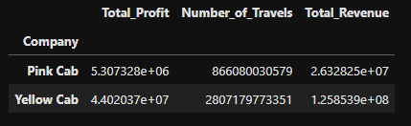
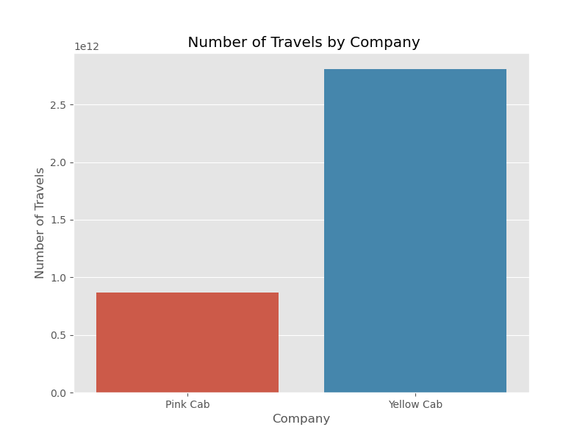
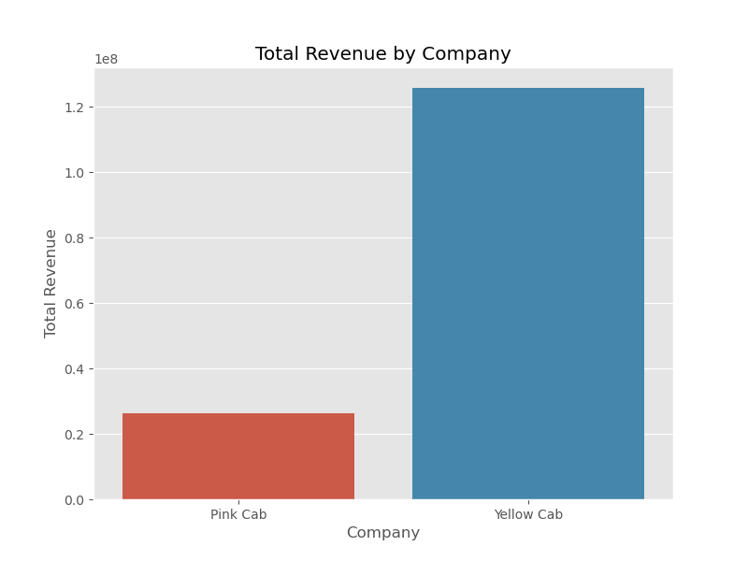
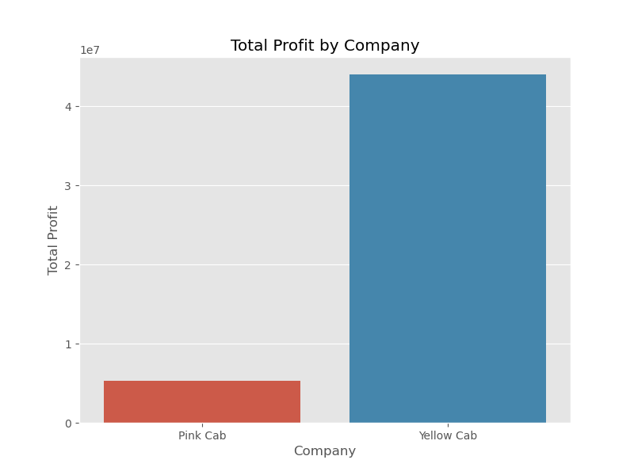
Profit Analysis
Analysis of Cab Performance
Table 1: Company Performance
Fig.2: Number of Travels by Company
Fig.3: Total Revenue by Company
Table 1. indicates that Yellow Cab makes more profit, has higher number of travels or rides by customers, and makes more revenue returns. Figure 1, Figure 2 and Figure 3. illustrates by visualizations the growth in profit, number of travels and revenue by Yellow Cab compared to Pink Cab.
Fig.1: Total Profit by Company

Slide 5
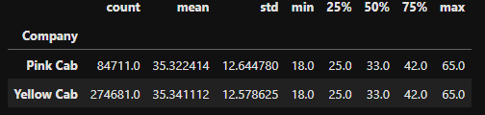
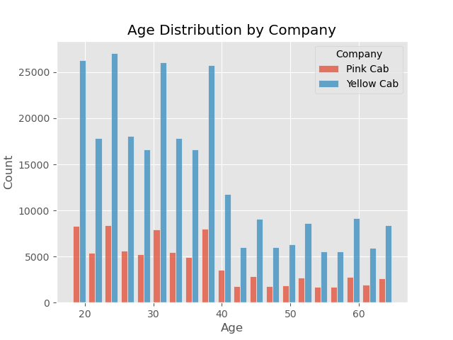
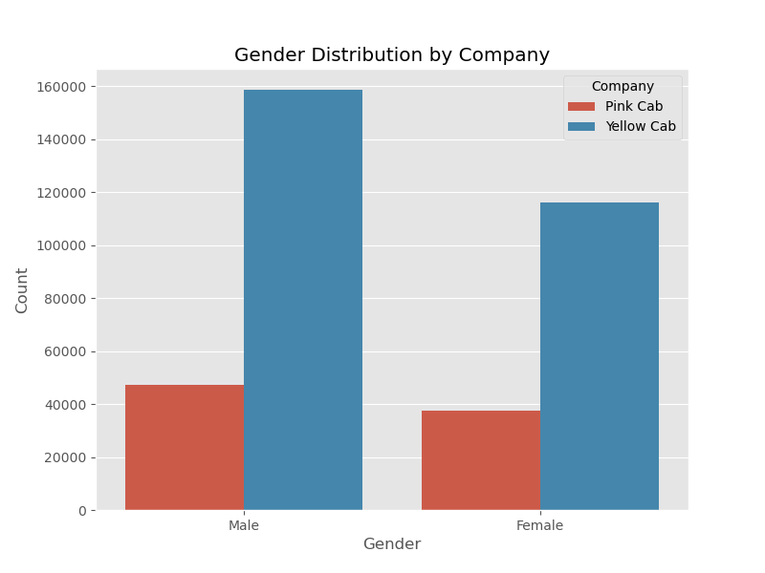
Analysis of Customer Demographics
Table 2 indicates the statistics of the Age distribution of the customers who use the services of both companies. It is observed that both companies have the same age distribution; however, the number of users within each age distribution, as observed in Figure 4. is higher for Yellow Cab than Pink Cab and the same observation applies to the Gender distribution illustrated in Figure 5.
Table 2: Statistics of the Age Distribution by Companies
Fig.4: Age Distribution by Company
Fig.5: Gender Distribution by Company

Slide 6
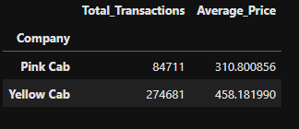
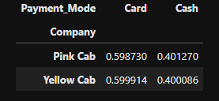
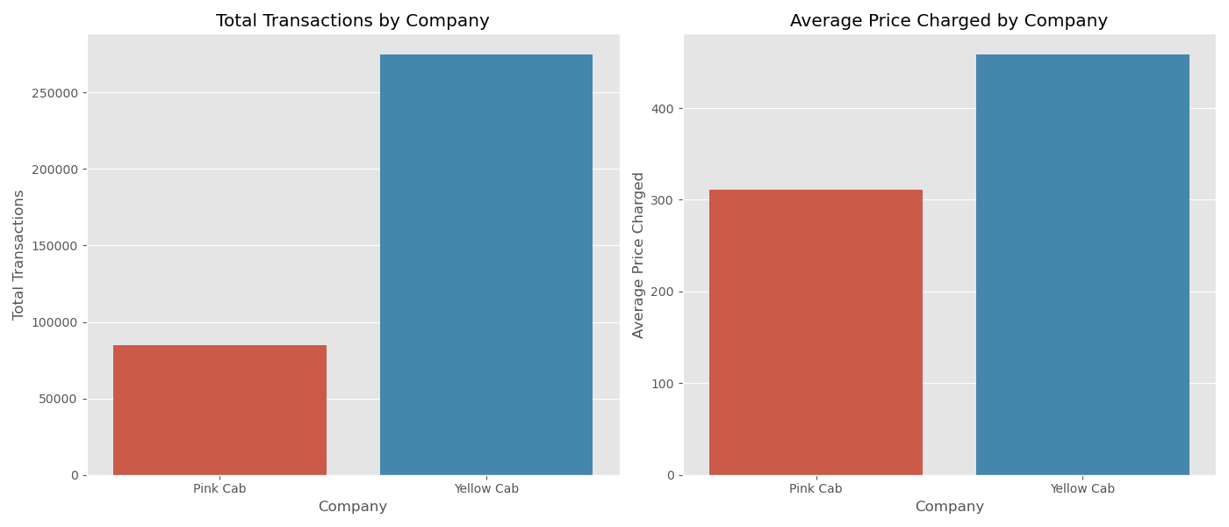
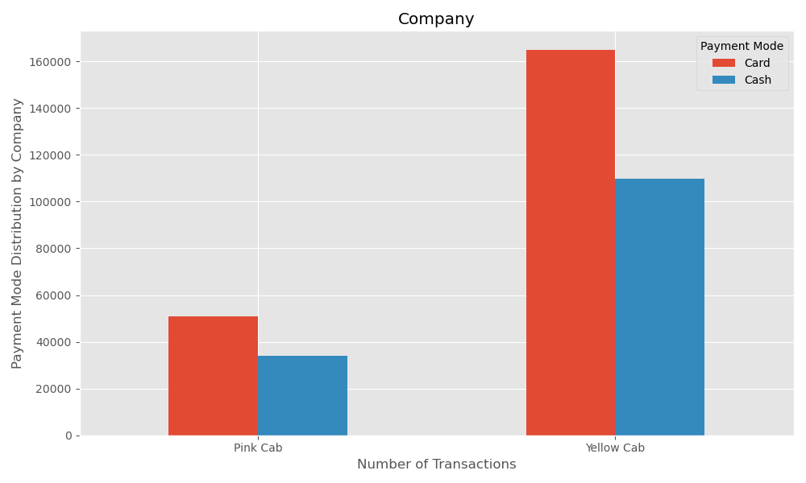
Analysis of Transaction Pattern
Tables 3 and 4 show the transaction pattern and payment modes of both companies. It is observed that Yellow Cab has the highest transaction, average price of trip and makes use of Card transfer in more cases for monetary issues. The illustrations of their growth in transaction and payment modes are shown in Figures 6 and 7, respectively.
Table 3: Transaction Patterns of Both Companies
Table 4: Payment Mode of Both Companies
Fig.6: Total Transaction and Average Price by Company
Fig.7: Payment Mode by Company

Slide 7
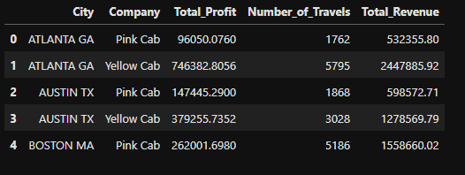
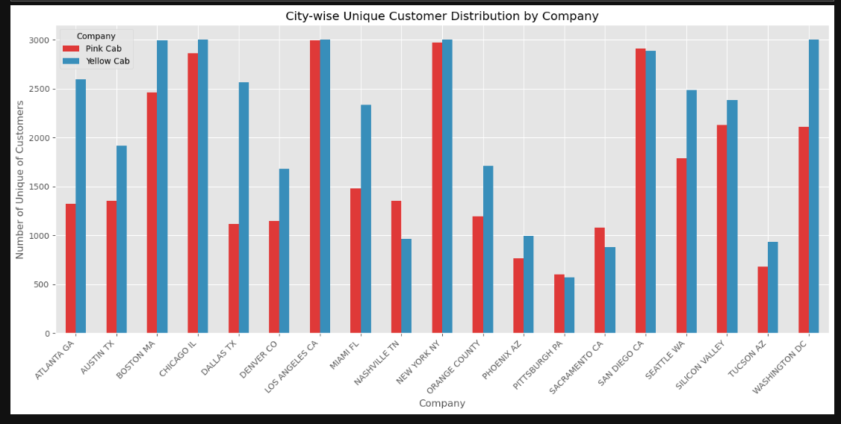
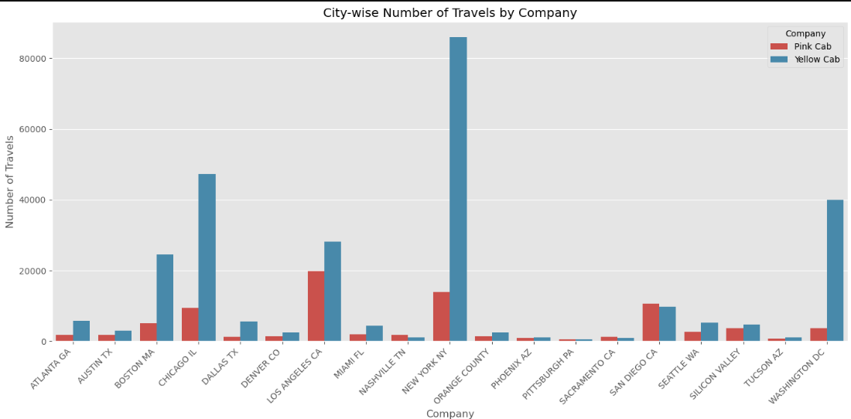
Analysis of the City-wise Distribution
Table 5. City Performance by Company
Fig.9: City-wise Unique Distribution by Company
Table 5 shows the first five rows of the City-wise performance of each company. It remains evident that Yellow Cab has the highest performance in terms of profit, number of travels and total revenue. Figure 8. illustrates the performance of the number of travels by city. Observation indicates that NEW YORK CITY NY, shows the highest recording for Yellow Cab. Similarly, per unique customer distribution, Yellow Cab on average has the highest recording with few exceptions in cities like NASHVILLE TN, PITTSBURGH PA and LOS ANGELES CA – having an equal record for both cities.
Fig.8: City-wise Number of Travels by Company

Slide 8
Recommendations
Upon evaluation and critical analysis, Yellow Cab is the best Cab for XYZ company to invest in based on the following observations:
Cab Performance: Yellow cab records the highest profit, number of travels and total revenue generated across the defined years
Customer Retention: It has the highest number of customers using their service, of which the majority are male users.
Transaction Pattern: Yellow cab records the highest transaction rate and average price per trip. It also has the highest number of rides or travels. It is a frequent user of cards as a mode of payment, giving its customers the flexibility to make payments without the necessity of having physical cash
City-wise Distribution: Yellow Cab has the highest number of users in all the considered cities of U.S, with NEW YORK NY recording the highest number of users.
In reference to the above analysis on both companies, I recommend Yellow cab for investment to XYZ company.

Slide 9
Thank You

